Slide 1

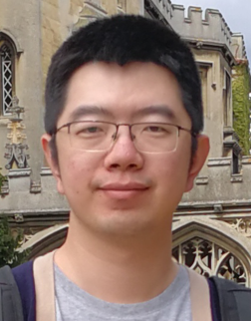
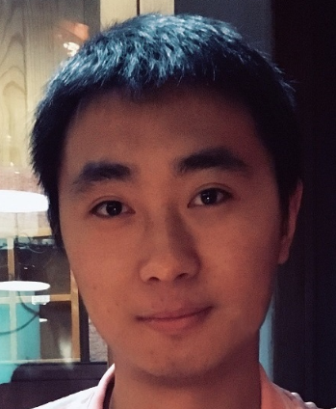
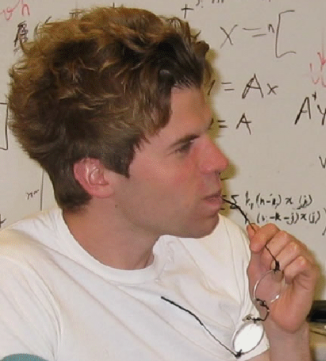
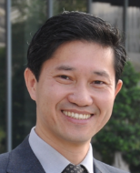
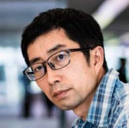
Image Smoothing via Unsupervised Learning
Qingnan Fan^{1,2}, Jiaolong Yang³, David Wipf³, Baoquan Chen^{4,1}, Xin Tong³
1Shandong University 2Beijing Film Academy 3Microsoft Research Asia 4Peking University
Notes:
Good morning everyone. Thank you for coming to our talk.
My name is Qingnan Fan, a final-year PhD student in Shandong University.
Today I’m going to talk about our recent work on utilizing unsupervised learning techniques to solve the image smoothing problem.

Slide 2
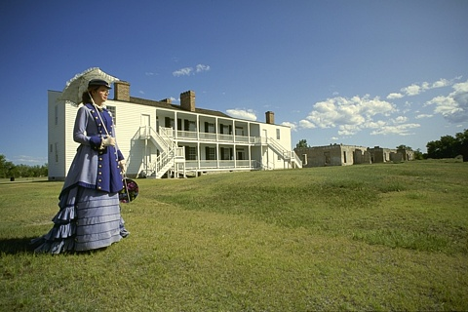
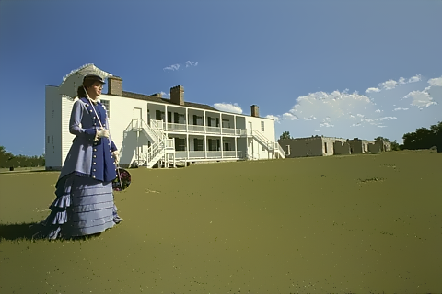
What is image smoothing?
Input
Smooth Image
Notes:
First of all, let’s take a look at what is image smoothing.
Image smoothing is an image processing technique developed to diminish unimportant details, while preserve primary image structures.

Slide 3
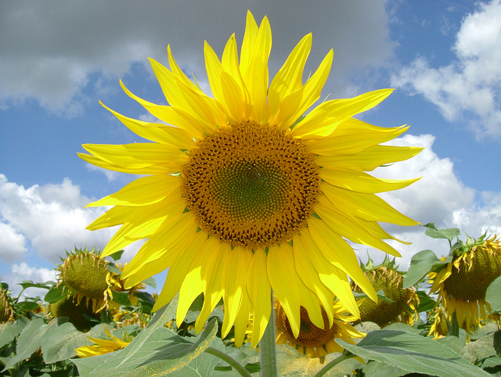
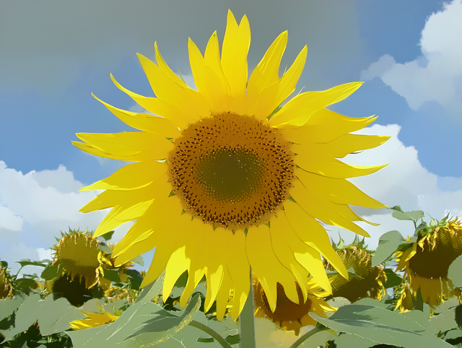
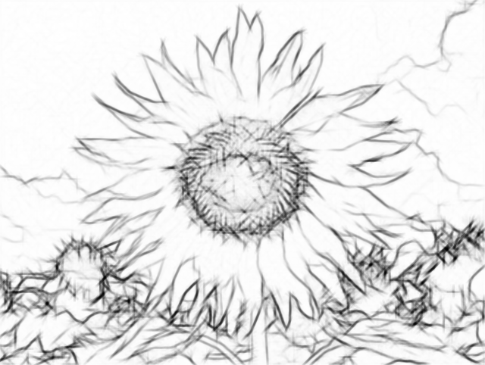
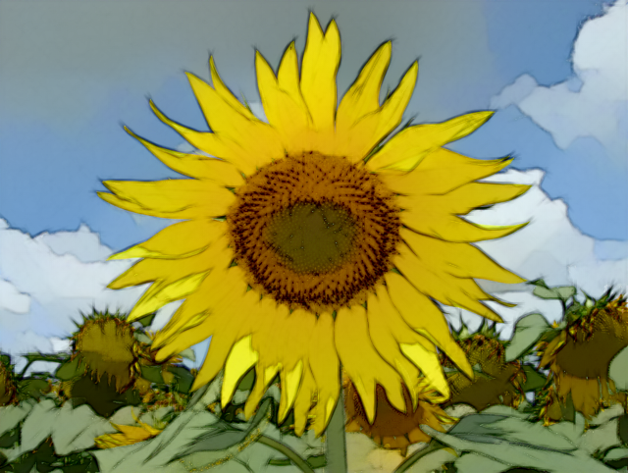
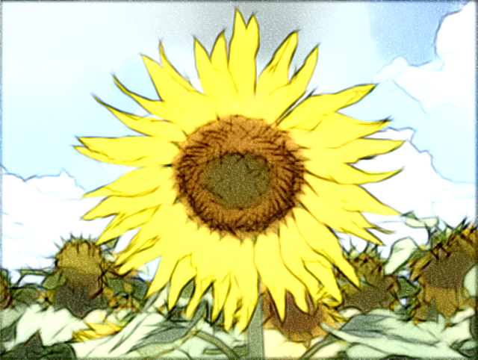
Application - abstraction
Input
Smooth Image
Pencil drawing
Abstraction
Abstraction w. tone mapping
Notes:
It can be applied to many applications, such as image abstraction,
Where the edges of smooth image can be extracted, and further decorated with random sketches in different directions to generate a pencil drawing picture
This image can be overlaid on the smooth image for an abstract look.

Slide 4
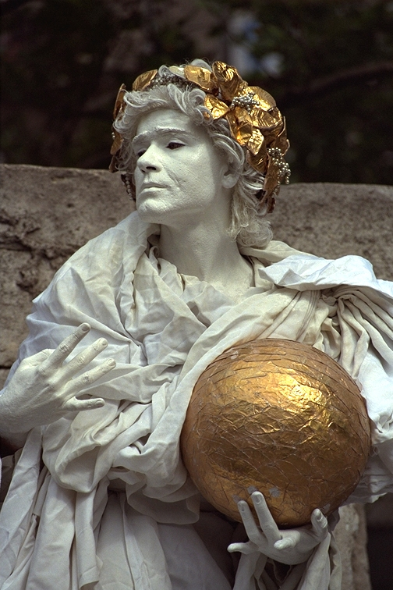
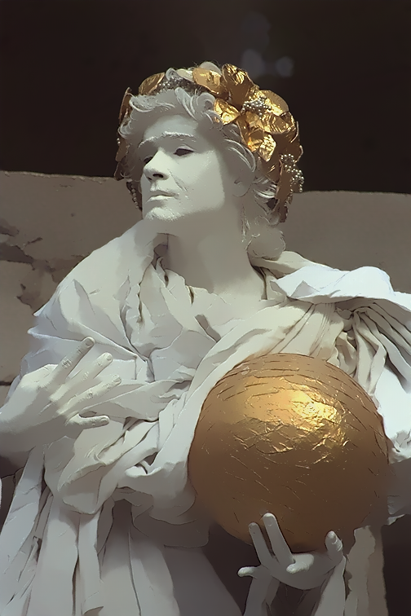
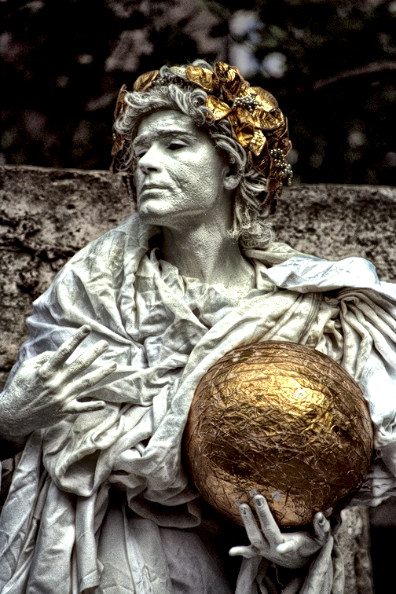
Application – detail enhancement
Input
Smooth Image
Detail exaggerated
Notes:
Given the input and smooth image,
the detail layer can be computed as the difference between the two images,
which can be further enhanced and superimposed on the smooth layer for a detail exaggerated image.

Slide 5
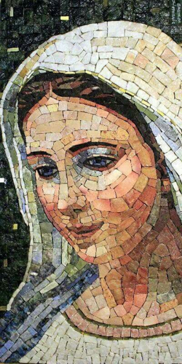
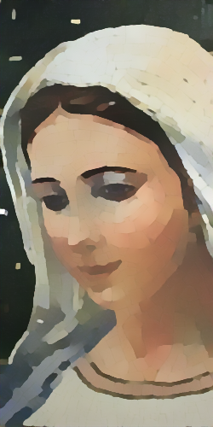
Application – texture removal
Input
Result
Notes:
For the pictures with repetitive patterns, image smoothing can also be modified to remove final-scale textures from the primary image structures.

Slide 6
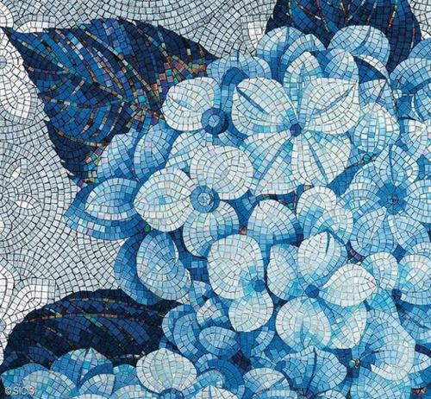

Challenges
Desired important structures adaptively changed from application to application
Slow running time
Edge-preserving smoothing
Texture removal
Notes:
However, this problem still has a couple of challenges.
Its desired important structures are adaptively changed from application to application.
For the example of the edge preserving smoothing, its structure is determined by the gradient magnitude.
While for texture removal, it’s measured by object scales.
Therefore, it’s difficult for a single smoothing algorithm to work well for all the different applications.

Slide 7
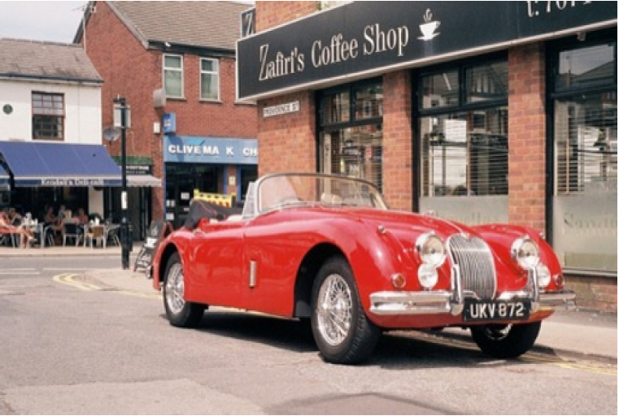
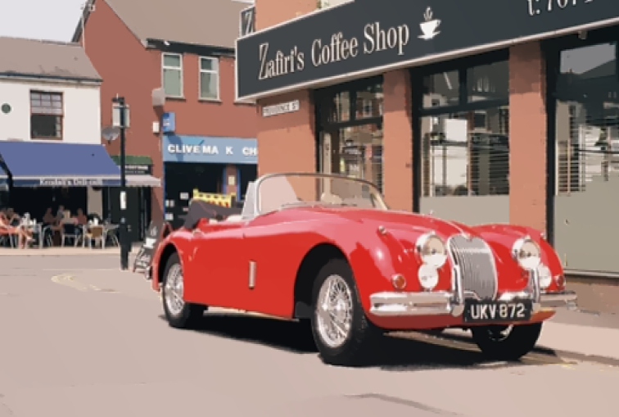
Challenges
Desired important structures adaptively changed from application to application
Slow running time
5-10 mins for a 500x300 image!
$L_{1}$ smoothing [Bi et al. 2015]
Notes:
On the other side, the state-of-the-art smoothing approaches are mostly optimization based, which is usually time-consuming.
The recent L1 smoothing takes 5-10 mins to process a 500x300 image.

Slide 8
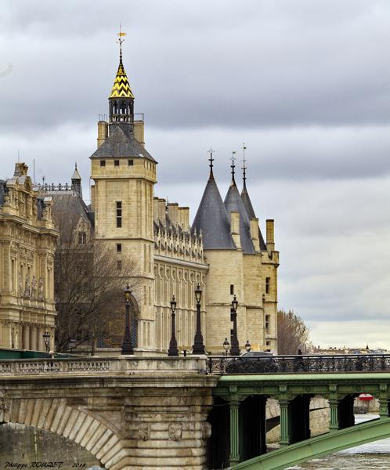
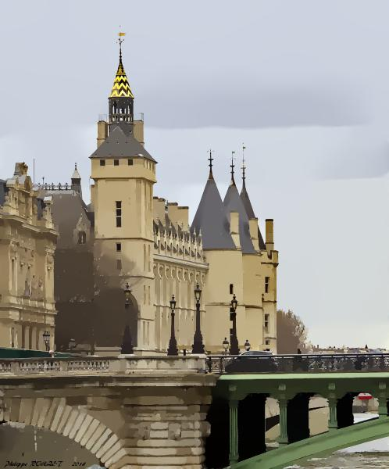

$L_{0}$ smoothing [Xu et al. 2011]
Notes:
Let’s take a look at two representative smoothing algorithms
L0 smoothing is a typical edge-preserving smoothing algorithm, which pursues strong smoothing effects.
However, it creates [click] some spurious edges which is caused by over-sharpening via strong regularizations.

Slide 9
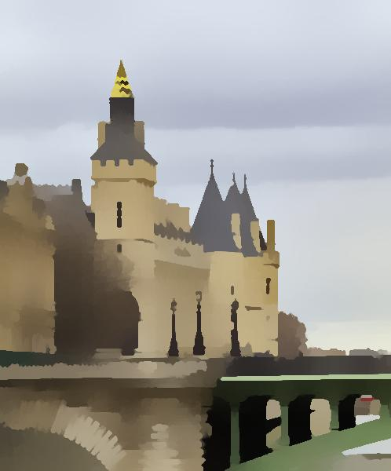
SGF [Zhang et al. 2015]
Notes:
Another recent work SGF, is designed for texture removal. however, in this case, it tends to over-smooth the image [click], and remove many important structures by mistake.

Slide 10
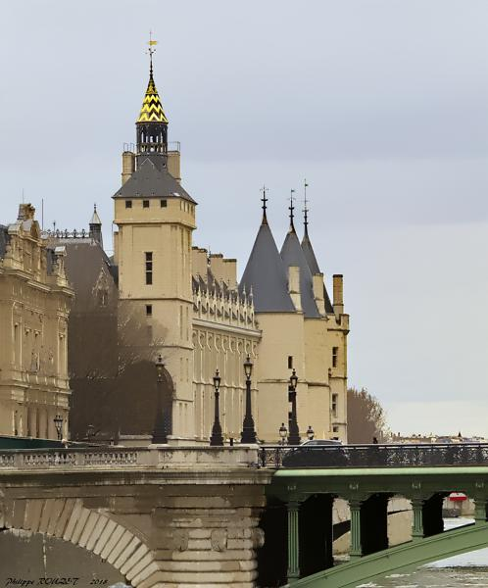
Ours
Notes:
And here’s our result, which doesn’t have these artifacts.

Slide 11
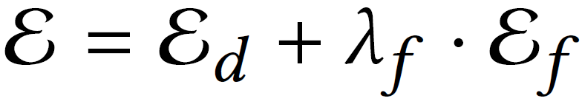
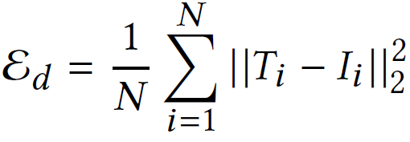
What is the core for image smoothing?
Which region to smooth? and what image structure to preserve?
data term
smooth term
Notes:
Before introducing our algorithm, let’s think about what is the core of image smoothing?
It’s [click] which region to smooth and what image structure to preserve.
The most state-of-the-art approaches seek an optimization solution for a robust and global smoothing effect.
Its typical objective function [click] is usually composed of a data term [click], which minimizes the difference between the target and input image, and also a smooth term [click]

Slide 12
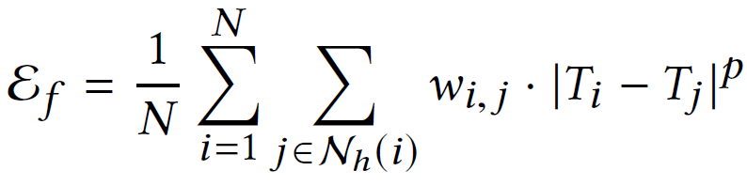
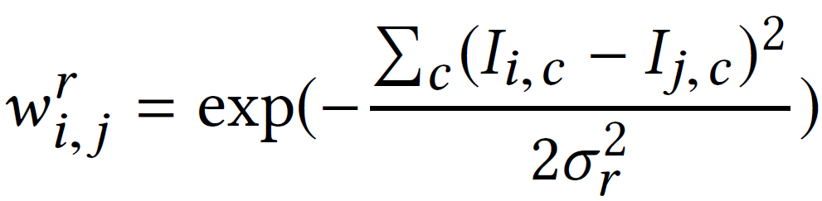
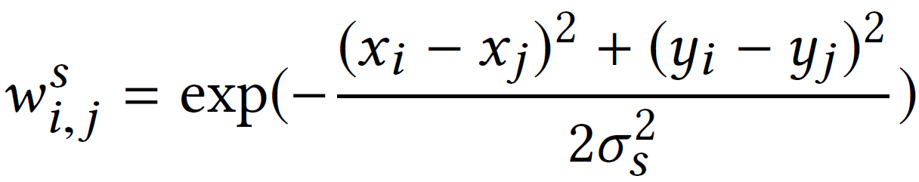
Regularization for image smoothing
Color affinity
Spatial affinity
Notes:
The smooth term is usually a regularization
It minimizes the Lp [click] difference between each pixel and its adjacent pixels, which is weighted [click] by either color affinity or spatial affinity..
However, what really dominate the smoothing results is the Lp norm.

Slide 13

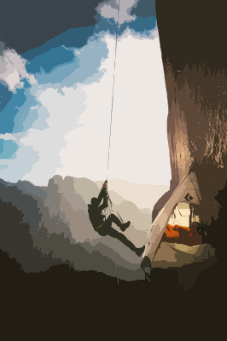
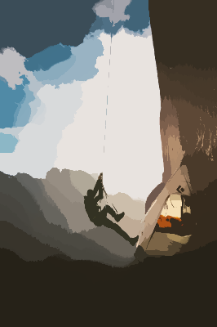
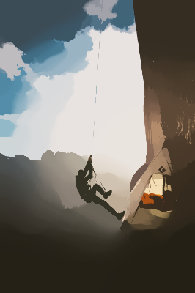
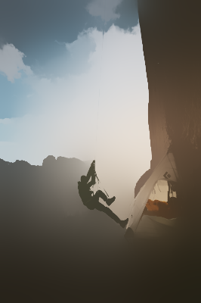
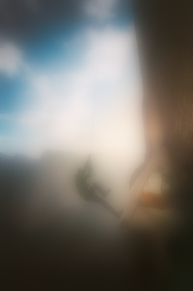
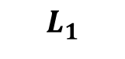
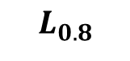
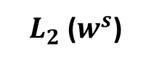
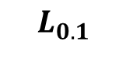
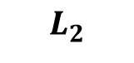
Regularization for image smoothing
Input
$L_{0.1}$
$L_{0.8}$
$L_{1}$
$L_{2}$
$L_{2}$ ($w^{s}$)
Notes:
So let’s take a look at the smoothing results regularized by different Lp norm.
We use color affinity by default to compute the weight, except for the rightmost one.

Slide 14

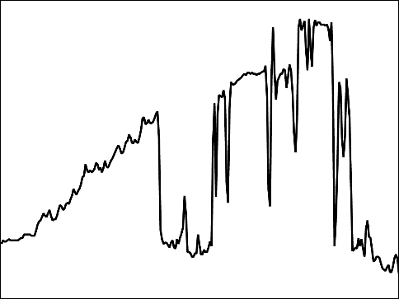
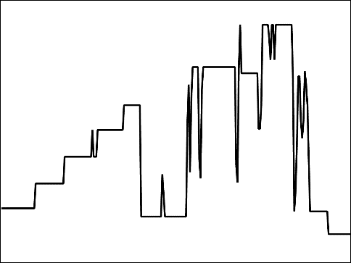
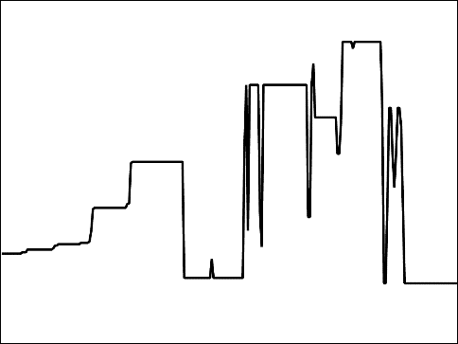
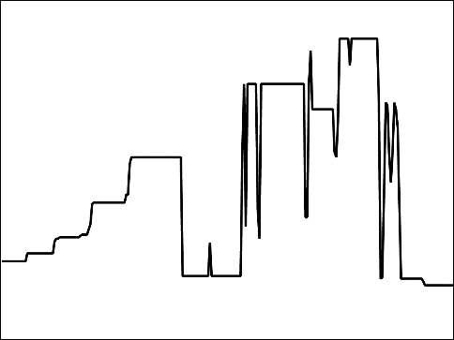
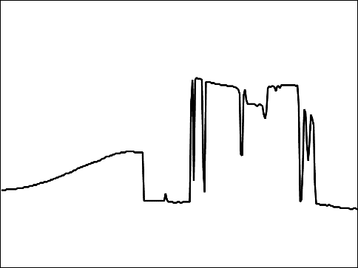
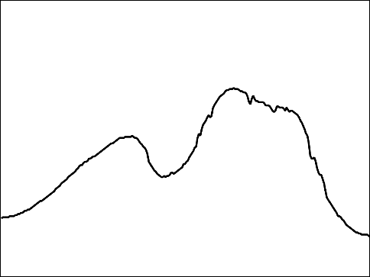
Regularization for image smoothing
Input
$L_{0.1}$
$L_{0.8}$
$L_{1}$
$L_{2}$
$L_{2}$ ($w^{s}$)
Notes:
For better visualization, we illustrate the brightness on the 1D image slice, identified by the horizontal red line as shown in the input.

Slide 15
Regularization for image smoothing
Input
$L_{0.1}$
$L_{0.8}$
$L_{1}$
$L_{2}$
$L_{2}$ ($w^{s}$)
Notes:
As you can see, for the small norm,
its advantage lies in it tends to preserve salient edges, like the hanging rope.
It also prefers the piece-wise constant effects, which is a good thing for image smoothing,
but on the other hand, it creates spurious edges; [click]

Slide 16
Regularization for image smoothing
Input
$L_{0.1}$
$L_{0.8}$
$L_{1}$
$L_{2}$
$L_{2}$ ($w^{s}$)
Notes:
While for a large norm, it doesn’t create spurious edges,
but it diminishes important structures,
and the result is more blurry than smooth [click].
Therefore we can see that a single regularization doesn’t always work well

Slide 17
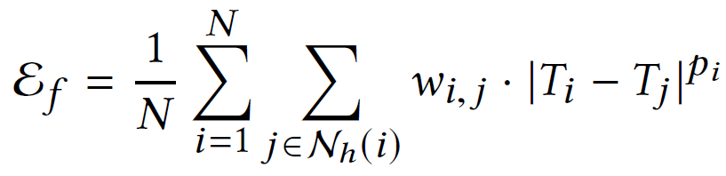
Dynamic Spatially-Variant $L_{p}$ Flattening Criterion
Notes:
In this paper, we propose …
Let’s take a look at the smoothing term again[click], where ours are developed based on.
What makes our flattening term spatially variant is that

Slide 18
Dynamic Spatially-Variant $L_{p}$ Flattening Criterion
Dynamic Spatially-Variant $L_{p}$ Flattening Criterion
Notes:
We modify the Lp norm to be adaptively changed from pixel to pixel,
The principle of deciding the per-pixel norm is as follows,

Slide 19
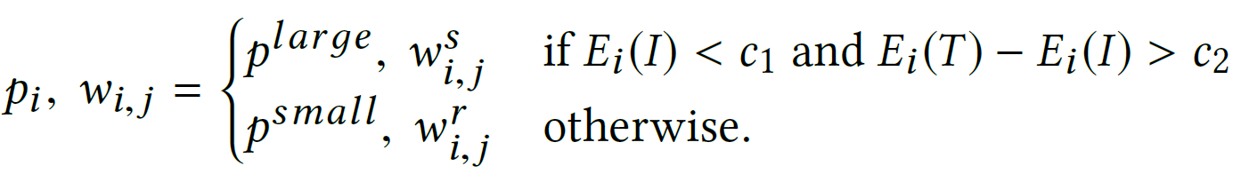
Dynamic Spatially-Variant $L_{p}$ Flattening Criterion

Slide 20
Dynamic Spatially-Variant $L_{p}$ Flattening Criterion
By default, we apply small $L_{p}$ and $w^{r}$ everywhere.
Input
Output
Notes:
By default we apply a small Lp norm everywhere, whose weight is computed by color affinity since we want to achieve strong smoothing effects

Slide 21
Dynamic Spatially-Variant $L_{p}$ Flattening Criterion
By default, we apply small $L_{p}$ and $w^{r}$ everywhere.
Input
Output
Notes:
Once we find it tends to over-sharpen the images by creating some spurious edges [click], that do not exist in the input image,

Slide 22
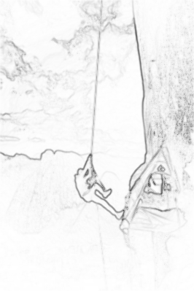
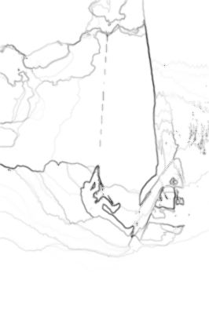
Dynamic Spatially-Variant $L_{p}$ Flattening Criterion
By default, we apply small $L_{p}$ and $w^{r}$ everywhere.
Input
Output

Slide 23
Dynamic Spatially-Variant $L_{p}$ Flattening Criterion
We apply large$L_{p}$ and $w^{s}$ in over-sharpened regions.
Input
Output
Notes:
we apply a large norm whose weight is computed by spatial affinity on those regions, to blur out the spurious edges.
This process is done iteratively, which means the flattening criterion is dynamically changing, instead of a fixed term.
In our implementation, L2 and L0.8 norm is used as the large and small norm empirically.

Slide 24
Dynamic Spatially-Variant $L_{p}$ Flattening Criterion
We apply large$L_{p}$ and $w^{s}$ in over-sharpened regions.
Input
Output
Notes:
However, the regularization only determines how to smooth, it preserves some image structures in an implicit way.
Remember we just discussed the important thing for image smoothing is not just about smoothing, but also preserve important structures. Regularization doesn’t achieve this in an explicit way,

Slide 25
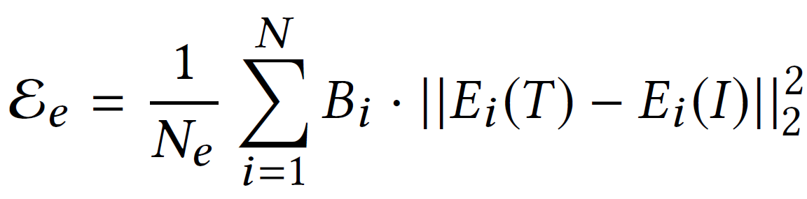
Edge-preserving Criterion
Notes:
To maintain the structures better, we propose … [click]
It minimizes the difference between output and input image in the edge domain,
which is computed simply as the brightness difference between each pixel and its surrounding pixels

Slide 26

Edge-preserving Criterion
Input
Output
Notes:
For this example, the tree twigs are too thin to be maintained well

Slide 27


Edge-preserving Criterion
Input
Output
Binary mask
Notes:
We compute the edge map for input and output image, and minimize their difference,
but only on the important structures [click] identified by the binary mask.

Slide 28

Edge-preserving Criterion
Input
Output
Binary mask
Notes:
After optimization, the non-important image structures defined in the binary mask are mostly diminished, but the important thin twigs are still preserved in our result.

Slide 29

Edge-preserving Criterion
Input
Output
Notes:
Correspondingly, the output smooth image also demonstrates the same phenomenon.
Note in this paper, our contribution doesn’t lie in finding the important image structures, since which is a more objective task.
We develop some naïve approach which proves effective for most images we test. However, it can be replaced by more sophisticated algorithms to further improve performance for sure.

Slide 30

The whole loss function
Notes:
Therefore, the whole objective function is the weighted combination of the three terms.

Slide 31




Ablation study - w/o $L_{0.8}$ norm
Input
w/o $L_{0.8}$ norm
Ours
Notes:
We validate our proposed energy function,
by removing a single component in the objective function each time.
For example, when we remove L0.8 norm, the optimized images look very blurry.

Slide 32



Ablation study - w/o $L_{0.8}$ norm
Input
w/o $L_{0.8}$ norm
Ours

Slide 33




Ablation study - w/o $L_{2}$ norm
Input
w/o $L_{2}$ norm
Ours
Notes:
And when we remove the L2 norm, it tends to over-sharpen some regions [click]

Slide 34



Ablation study - w/o $L_{2}$ norm
Input
w/o $L_{2}$ norm
Ours

Slide 35



Ablation study - w/o edge-preserving term
Input
w/o edge-preserving term
Ours
Notes:
The thin ropes shown here demonstrate a very challenging case, where w/o edge-preserving term, it’s mostly diminished.

Slide 36



Ablation study - w/o edge-preserving term
Input
w/o edge-preserving term
Ours

Slide 37

How to optimize the objective function?
Traditional numerical solvers:
Gradient Descent method, such as Adam
Iterative Reweighted Least Square (IRLS)
…
Drawback:
Tens or hundreds of iterations are required for optimization.
Extra inputs are required.
Notes:
Until now, we haven’t touched the part how this objective function is optimized …
Well, it can be optimized by some traditional numerical solvers for sure,
However, usually it takes tens or hundreds of iterations for optimization.
And for each iteration, some extra information like the detected edges need to be fed for optimization.

Slide 38

How about a deep learning solver?
The differentiable objective function is implemented in the deep learning framework.
Training:
Extra inputs are still required
Millions of iterations for training
Notes:
However, what if we leverage a deep learning solver?
In the training stage, the input is fed to a deep network to generate an output,
which is further fed to the objective function for optimization by gradient descent, whose computed gradients are back propagated to modify the neural network.

Slide 39
How about a deep learning solver?
The differentiable objective function is implemented in the deep learning framework.
Training:
Extra inputs are still required
Millions of iterations for training
Notes:
As long as the objective function is differentiable, a deep learning solution can be explored here.
Since no ground truth label is defined in the objective function, the whole process is unsupervised learned
In our framework, the deep network is treated not as a regressor, not as a classifier, but as an optimizer.

Slide 40

How about a deep learning solver?
Evaluation:
All the extra input information and optimization process is learned within the deep network, and no longer needed.
Only one forward pass is required
Notes:
During evaluation, All the extra input information and optimization process is learned within the deep network, and no longer needed.
Our deep network only requires one forward pass to process the image, which is much more efficient

Slide 41




Visual comparison between different optimizers
Input
IRLS
Adam
Ours
Notes:
In this case, we visualize some results optimized by different solvers
traditional optimizers still tend to over-sharpen some local regions.
To get to know more about these optimizers, we analyze the numerical and visual performance of these solvers.
Besides the three optimizers, we also leverage a deep learning solver which is trained only on a single image, and hence works in a similar way as Adam and IRLS in principle, denoted as Ours (overit).

Slide 42

Performance analysis of different optimizers
Loss trend during evaluation ($L_{2}$)
Notes:
We start with a simple case where only L2 norm is applied in the loss function, and hence it is convex.
IRLS achieves the optimal result with one iteration, while the other three are all far from optimal

Slide 43






Performance analysis of different optimizers
$L_{2}$
Input
IRLS
Adam
Ours
Ours (overfit)
Notes:
Visually, IRLS achieves the ideally blurry effects, while the others achieve less satisfactory results defined by L2 norm.

Slide 44

Performance analysis of different optimizers
Loss trend during evaluation ($L_{0.8}$)
Notes:
Then we replace the L2 norm with L0.8 norm, which makes the objective function nonconvex,
both IRLS and Adam achieves the lowest, followed by ours (overfit) and ours

Slide 45





Performance analysis of different optimizers
$L_{0.8}$
Input
IRLS
Adam
Ours
Ours (overfit)
Notes:
As can also be seen, IRLS and Adam achieve the most piece-wise constant effects.

Slide 46

Performance analysis of different optimizers
Loss trend during evaluation (Half $L_{2}$, half $L_{0.8}$ )
Notes:
What if the loss function is a fixed mixture of both regularizations, then loss trend looks like a combination of the above two, and IRLS still has the best numerical result.
From all the above three numerical comparisons, we can see that the deep learning solver doesn’t have any advantage.
That is because for traditional optimizers, it’s optimized over each single image iteratively to achieve the best result on that specific image, while the deep learning solver learns a general knowledge from hundreds of thousands of images, but doesn’t show bias on a specific case.

Slide 47





Performance analysis of different optimizers
Half $L_{2}$, half $L_{0.8}$
Input
IRLS
Adam
Ours
Ours (overfit)
Notes:
And here’s the visual results.

Slide 48




Performance analysis of different optimizers
Adaptive norm
Input
IRLS
Adam
Ours
Ours (overfit)
Notes:
Finally we switch the regularization with our dynamically changed one, in which case numerical comparison is less informative. We observe the over-sharpening effects for IRLS, Adam and ours (overfit), but not in our full pipeline.
The potential reason for that is our deep network learns an implicit combination of different regularizations, which reflects such an information on each image pixel during evaluation. While the other three still tends to achieve an optimal result under each iteration, which may generally obtains the best performance via numerical error, but not by visual inspection.

Slide 49

Running time comparison
Notes:
Here we compare the running time of different algorithms under a few image resolutions. As can be seen, Our method is much faster than traditional algorithms,
A few recent deep learning approaches accelerate the traditional smoothing algorithms by simulating their smoothing effects, which is denoted as Approximation CNN here, but doesn’t demonstrate a similar logic as ours.

Slide 50

Detailed network structure
Notes:
Fully convolutional neural network with residual connection.

Slide 51

Ablation study

Slide 52





Application – image abstraction
Input
WLS
$$L_{0}$$
Ours
Notes:
We demonstrate our algorithm on the image abstraction application, and compare it with two other approaches.
As can be seen, our results preserve much better structures, especially on the tree twigs

Slide 53



Application – image abstraction
Input
WLS
$$L_{0}$$
Ours
Notes:
This can be better observed in the pencil drawing image,

Slide 54



Application – image abstraction
Input
WLS
$$L_{0}$$
Ours
Notes:
The pencil drawing can be further superimposed on the smooth image to generate the abstract look.

Slide 55






Application – detail enhancement
Input
WLS
$$L_{0}$$
FGS
Ours
Notes:
As for the detail enhancement, we first generate the smooth image

Slide 56





Application – detail enhancement
Input
WLS
$$L_{0}$$
FGS
Ours
Notes:
and then compute the detail layer for further enhancement.

Slide 57





Application – detail enhancement
Input
WLS
$$L_{0}$$
FGS
Ours
Notes:
We zoom in to the region identified by the white rectangle in the input image, where L0 and FGS shows strong gradient reversal artifacts, while ours does not.

Slide 58




Application – texture removal
Notes:
By simply modifying our objective function to determine the eliminated structure as the repetitive fine-scale patterns, we are able to implement the texture removal effects

Slide 59




Application – texture removal

Slide 60



Application – content-aware image manipulation
Input
Background smooth
Saliency
Notes:
Our objective function can also be facilitated by saliency map, which guides the network to smooth only the background regions.
During evaluation, no saliency information is needed, since it’s defined in the objective function and learned within the neural network jointly with the smoothing effects.

Slide 61



Application – content-aware image manipulation
Input
Background smooth
Saliency

Slide 62



Application – content-aware image manipulation
Input
Foreground enhance
Saliency
Notes:
We can also learn to only smooth the foreground region, and also exaggerate the details only on the foreground later on.

Slide 63



Application – content-aware image manipulation
Input
Foreground enhance
Saliency

Slide 64


Input
Background smooth
Notes:
And here’s another image, which demonstrates a perfect case for our background smooth application.

Slide 65


Input
Background smooth

Slide 66
A few more things
In JOB MARKET.
Actively looking for POSTDOC!
Codes and model released in https://github.com/fqnchina/ImageSmoothing
Notes:
I’m a final year PhD student, actively looking for postdocs. If you are interested in my research, feel free to contact me.
That’s basically everything. Thank you for your attention and I’m happy to take questions. Thank you.

Slide 67
Thank You
Notes:
.

Slide 68

Qingnan Fan
Background
final-year PhD student in Shandong University, located in Qingdao, China.
Supervised by Prof. Baoquan Chen.
Previous work:
Video Segmentation (SIGGRAPH Asia 2015), Reflection Removal (ICCV 2017), Intrinsic Image Decomposition (CVPR 2018), Decouple Learning (ECCV 2018), Image Smoothing (SIGGRAPH Asia 2018)
Research Experience:
Cambridge University, Microsoft Research Asia, Tel Aviv University.

